Slide 1
Introduction to jQuery
Some slides from: BreadFish

Slide 2
JavaScript
A script language interpreted by browser
OOP (prototype based, not class based)
Dynamic typing
Run-time evaluation

Slide 3
JavaScript
Cannot access host computer (except cookie)
Same origin policy
Non-persistence
Cannot access history object
Cannot write the value of file upload field

Slide 4
JavaScript Libraries
jQuery
Mootools
Prototype
YUI

Slide 5
Introduction to jQuery
Developed in 2006 by John Resig at Rochester Institute of Technology
jQuery is a lightweight JavaScript library that emphasizes interaction between JavaScript and HTML
jQuery is free, open source software Dual-licensed under the MIT License and the GNU General Public License
Helps web developers to create simple pieces of interaction without being forced to write long, complex, book-length pieces of code

Slide 6
Introduction to jQuery
Why do I want it
  Rich Internet Applications (RIA)
  Dynamic HTML (DHTML)
How do I get it
  www.jquery.com
How can I learn it
  jQuery in Action by Bibeault & Katz, Manning
  jQuery Visual Quickstart Guide by Holzner, Peachpit
  www.jquery.com
  docs.jquery.com
  www.visualjquery.com
  www.Jqueryfordesigners.com
  www.gscottolson.com/weblog/ - cheat sheet
  www.javascripttoolbox.com/jquery
  http://www.w3schools.com/jquery/jquery_examples.asp

Slide 7
Summary
Introduction, installation, “Howdy World”, Ready function, DOM, Selecting and Formatting web page elements
Events and Animations
jQuery Plugin libraries
AJAX

Slide 8
What jQuery Does
“Unobtrusive” JavaScript
  separation of behavior from structure
CSS
  separation of style from structure
Allows adding JavaScript to your web pages
Advantages over just JavaScript
  Much easier to use
  Eliminates cross-browser problems

Slide 9
5 Things jQuery Provides
Select DOM (Document Object Model) elements on a page – one element or a group of them
Set properties of DOM elements, in groups (“Find something, do something with it”)
Creates, deletes, shows, hides DOM elements
Defines event behavior on a page (click, mouse movement, dynamic styles, animations, dynamic content)
AJAX calls

Slide 10
The DOM
Document Object Model
jQuery is “DOM scripting”
Heirarchal structure of a web page
You can add and subtract DOM elements on the fly
You can change the properties and contents of DOM elements on the fly

Slide 11
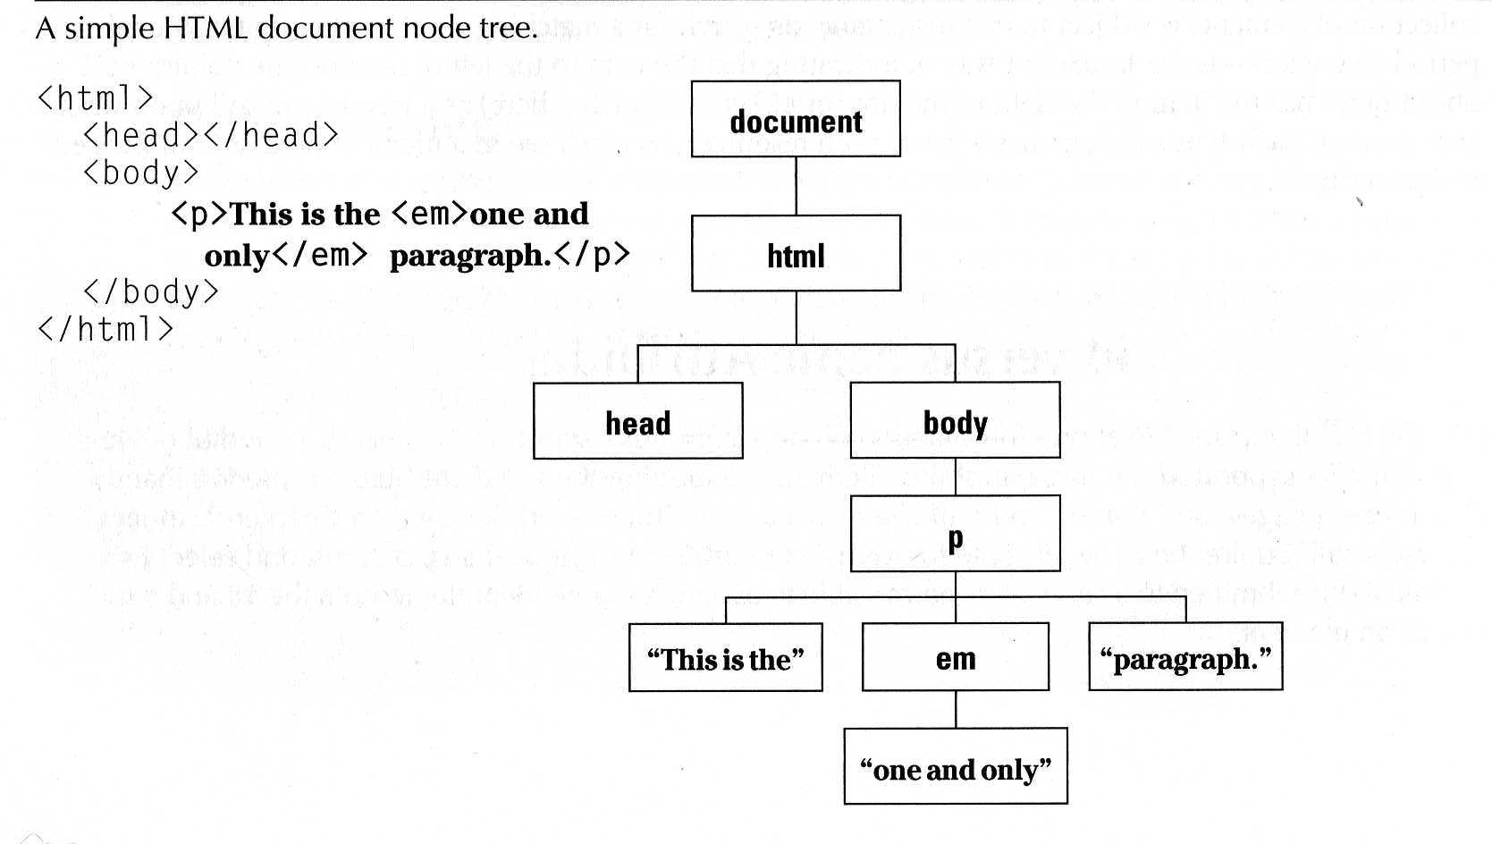
The DOM
“a cross-platform and language-independent convention for representing and interacting with objects in HTML, XHTML and XML documents. Aspects of the DOM (such as its "Elements") may be addressed and manipulated within the syntax of the programming language in use.” Wikipedia

Slide 12
The jQuery Function
jQuery() = $()
$(function) The “Ready” handler
$(‘selector’) Element selector expression
$(element) Specify element(s) directly
$(‘HTML’) HTML creation
$.function() Execute a jQuery function
$.fn.myfunc(){} Create jQuery function

Slide 13
The Ready Function
Set up a basic HTML page and add jQuery
Create a “ready” function
Call a function
5 ways to specify the ready function
  $(document).ready(function(){…};);
  $().ready(function(){…};)
  $(function(){…};)
  jQuery(dofunc);
  $(dofunc);

Slide 14
Selecting Elements – Creating a “wrapped set”
$(selector)
selector:
  $(‘#id’) id of element
  $(‘p’) tag name
  $(‘.class’) CSS class
  $(‘p.class’) <p> elements having the CSS class
  $(‘p:first’) $(‘p:last’) $(‘p:odd’) $(‘p:even’)
  $(‘p:eq(2)’) gets the 3rd <p> element (0 based)
  $(‘p’)[1] gets the 2nd <p> element (0 based)
  $(‘p:nth-child(3)) gets the 3rd <p> element of its parent.
  $(‘p:nth-child(odd)) gets the odd <p> element of its parent.
  $(‘p:nth-child(5n+1)’) gets the 1st element after every 5th one
  $(‘p a’) <a> elements, descended from a <p>
  $(‘p>a’) <a> elements, direct child of a <p>
  $(‘p+a’) <a> elements, directly following a <p>
  $(‘p, a’) <p> and <a> elements
  $(‘li:has(ul)’) <li> elements that have at least one <ul> descendent
  $(‘:not(p)’) all elements but <p> elements
  $(‘p:hidden’) only <p> elements that are hidden
  $(‘p:empty’) <p> elements that have no child elements

Slide 15
Selectors
<html>
<head>
<title>The jQuery Example</title>
<script type = "text/javascript"
src = "https://ajax.googleapis.com/ajax/libs/jquery/2.1.3/jquery.min.js">
</script>
<script type = "text/javascript" language = "javascript">
$(document).ready(function() {
$("p").css("background-color", "yellow");
});
</script>
</head>
<body>
<div>
<p class = "myclass">This is a paragraph.</p>
<p id = "myid">This is second paragraph.</p>
<p>This is third paragraph.</p>
</div>
</body>
</html>
https://www.tutorialspoint.com/jquery/jquery-selectors.htm

Slide 16
Selecting Elements, cont.
$(‘img’[alt]) <img> elements having an alt attribute
$(‘a’[href^=http://]) <a> elements with an href attribute starting with ‘http://’
$(‘a’[href$=.pdf]) <a> elements with an href attribute ending with ‘.pdf’
$(‘a’[href*=ntpcug]) <a> elements with an href attribute containing ‘ntpcug’

Slide 17
Useful jQuery Functions
.each() iterate over the set
.size() number of elements in set
.end() reverts to the previous set
.get(n) get just the nth element (0 based)
.eq(n) get just the nth element (0 based) also .lt(n) & .gt(n)
.slice(n,m) gets only nth to (m-1)th elements
.not(‘p’) don’t include ‘p’ elements in set
.add(‘p’) add <p> elements to set
.remove() removes all the elements from the page DOM
.empty() removes the contents of all the elements
.filter(fn/sel) selects elements where the func returns true or sel
.find(selector) selects elements meeting the selector criteria
.parent() returns the parent of each element in set
.children() returns all the children of each element in set
.next() gets next element of each element in set
.prev() gets previous element of each element in set
.siblings() gets all the siblings of the current element
https://www.tutorialspoint.com/jquery/jquery-utilities.htm

Slide 18
css(property, value)
<html>
<head>
<title>The jQuery Example</title>
<script type = "text/javascript"
src = "https://ajax.googleapis.com/ajax/libs/jquery/2.1.3/jquery.min.js">
</script>
<script type = "text/javascript" language = "javascript">
$(document).ready(function() {
$("div:first").width(100);
$("div:first").css("background-color", "blue");
});
</script>
<style>
div {
width:70px; height:50px; float:left;
margin:5px; background:red; cursor:pointer;
}
</style>
</head>
<body>
<div></div>
<div>d</div>
<div>d</div>
<div>d</div>
<div>d</div>
</body>
</html>

Slide 19
Formatting Elements-html()
<html>
<head>
<title>The jQuery Example</title>
<script type = "text/javascript"
src = "https://ajax.googleapis.com/ajax/libs/jquery/2.1.3/jquery.min.js">
</script>
<script type = "text/javascript" language = "javascript">
$(document).ready(function() {
$("div").click(function () {
var content = $(this).html();
$("#result").text( content );
});
});
</script>
<style>
#division{ margin:10px;padding:12px; border:2px solid #666; width:60px;}
</style>
</head>
<body>
<p>Click on the square below:</p>
<span id = "result"> </span>
<div id = "division" style = "background-color:blue;">
This is Blue Square!!
</div>
</body>
</html>

Slide 20
Add Page Elements
$(‘#target’).before(‘<p>Inserted before #target</p>’);
$(‘#target’).after(‘<p>This is added after #target</p>’);
$(‘#target’).append(‘<p>Goes inside #target, at end</p>’);
$(‘#target’).wrap(‘<div></div>’);

Slide 21
Adding Events
Mouseover events – bind, hover, toggle
Button click events
Keystrokes

Slide 22
Event Background
DOM Level 2 Event Model
  Multiple event handlers, or listeners, can be established on an element
  These handlers cannot be relied upon to run an any particular order
  When triggered, the event propagates from the top down (capture phase) or bottom up (bubble phase)
  IE doesn’t support the “capture phase”

Slide 23
Basic Syntax of Event Binding
$(‘img’).bind(‘click’, function(event){alert(‘Howdy’;});
$(‘img’).bind(‘click’, imgclick(event));
  Allows unbinding the function
$(‘img’).unbind(‘click’, imgclick());
$(‘img’).unbind(‘click’);
$(‘img’).one(‘click’, imgclick(event));
  Only works once
$(‘img’).click(imgclick);
$(‘img’).toggle(click1, click2);
$(‘img’).hover(mouseover, mouseout);
https://www.tutorialspoint.com/jquery/jquery-events.htm

Slide 24
Basic Syntax of Event Binding
<html>
<head>
<title>The jQuery Example</title>
<script type = "text/javascript"
src = "https://ajax.googleapis.com/ajax/libs/jquery/2.1.3/jquery.min.js">
</script>
<script type = "text/javascript" language = "javascript">
$(document).ready(function() {
$('div').bind('click', function( event ){
alert('Event type is ' + event.type);
alert('pageX : ' + event.pageX);
alert('pageY : ' + event.pageY);
alert('Target : ' + event.target.innerHTML);
});
});
</script>
<style>
.div{ margin:10px;padding:12px; border:2px solid #666; width:60px;}
</style>
</head>
<body>
<p>Click on any square below to see the result:</p>
<div class = "div" style = "background-color:blue;">ONE</div>
<div class = "div" style = "background-color:green;">TWO</div>
<div class = "div" style = "background-color:red;">THREE</div>
</body>
</html>

Slide 25
Element Properties – “this”
this
this.id
this.tagName
this.attr
this.src
this.classname
this.title
this.alt
this.value (for form elements)

Slide 26
‘Event’ properties
event.target→ref to element triggering event
Event.target.id→id of element triggering event
event.currentTarget
event.type→type of event triggered
event.data→second parm in the bind() func
Various mouse coordinate properties
Various keystroke related properties

Slide 27
Event Methods
.stopPropagation() no bubbling
.preventDefault() no <a> link, no <form> submit
.trigger(eventType) does not actually trigger the event, but calls the appropriate function specified as the one tied to the eventType
.click(), blur(), focus(), select(), submit()
    With no parameter, invokes the event handlers, like trigger does, for all the elements in the wrapped set

Slide 28
Shortcut Event Binding
.click(func)
.submit(func)
.dblclick(func)
.mouseover(func)
.mouseout(func)
.select(func)

Slide 29
Useful Event Functions
.hide() display:none
.show() display:true
.toggle(func1, func2) first click calls func1, next click executes func2
.hover(over, out) mouseover, mouseout
https://www.tutorialspoint.com/jquery/jquery-effects.htm

Slide 30
Useful Event Functions
<html>
<head>
<title>The jQuery Example</title>
<script type = "text/javascript"
src = "https://ajax.googleapis.com/ajax/libs/jquery/2.1.3/jquery.min.js">
</script>
<script type = "text/javascript" language = "javascript">
$(document).ready(function() {
$("#show").click(function () {
$(".mydiv").show( 1000 );
});
$("#hide").click(function () {
$(".mydiv").hide( 1000 );
});
});
</script>
<style>
.mydiv{
margin:10px;
padding:12px;
border:2px solid #666;
width:100px;
height:100px;
}
</style>
</head>
<body>
<div class = "mydiv">
This is a SQUARE
</div>
<input id = "hide" type = "button" value = "Hide" />
<input id = "show" type = "button" value = "Show" />
</body>
</html>

Slide 31
jQuery Core
jQuery(selector, [ context ]): Accepts a string containing a CSS selector which is then used to match a set of elements and returns a jQuery object.
  jQuery(element)
  jQuery(elementArray)
  jQuery(jQuery object)
  jQuery()
can be written as $()

Slide 32
jQuery Events
.ready(handler) : execute handler when the DOM is fully loaded.
js
js
function printhello(){
$(“#hello”).html(“Hello, jQuery!”);
}
$(document).ready(printhello());
$(document).ready(function(){
$(“#hello”).html(“Hello, jQuery!”);
});
Same as window.onload???

Slide 33
jQuery Events
.bind()
.blur()
.change()
.click()
.focus()
.hover()
.select()
.toggle()
.trigger()
.submit()
.mousedown()
.mouseenter()
.mouseleave()
.keypress()
.keyup()

Slide 34
jQuery Events
$(document).keyup(function(event) {
switch(event.which) {
case 32:
alert(“32 pressed”);
break;
}
});
event.preventDefault()
event.stopPropagation()

Slide 35
jQuery Selectors
follows CSS1~3 Selectors
http://www.w3.org/TR/css3-selectors
:animated
:has()
:gt()

Slide 36
jQuery Attributes
.addClass()
.removeClass()
.hasClass()
.toggleClass()
.attr()
.removeattr()
.val()
.html()

Slide 37
jQuery Each
.each() : Iterate over a jQuery object, executing a function for each matched element.
html
js
<ul>
<li>garbage</li>
<li>food</li>
<li>abroad</li>
</ul>
$(document).ready(function(){
$('li').each(function(index) {
alert(index + ': ' + $(this).text());
});
});

Slide 38
jQuery Traversing
.add()
.children()
.contents()
.filter()
.find()
.next()
.not()
.prev()

Slide 39
jQuery Manipulations
.append()
.appendTo()
.clone()
.detach()
.insertAfter()
.insertBefore()
.remove()

Slide 40
jQuery CSS
.css()
.height()
.width()
.position()
.offset()
.scrollTop()
.scrollLeft()

Slide 41
jQuery Effect
js
.animate()
$(document).ready(function(){
$(".block").css({
'position': 'absolute',
'backgroundColor': "#abc",
'left': '100px',
'width': '90px',
'height': '90px',
'margin': '5px' });
$("#left").click(function(){
$(".block").animate({left: "-=50px"}, "slow");
});
$("#right").click(function(){
$(".block").animate({left: "+=50px"}, "slow");
});
});
html
<button id="left">left</button>
<button id="right">right</button>
<div class="block"></div>

Slide 42
jQuery Effect
.fadeIn()
.hide()
.show()
.toggle()

Slide 43
AJAX
Asynchronous JavaScript And XML
The basic AJAX function – XMLHttpRequest
Initiating a request
Getting the response

Slide 44
jQuery AJAX
jQuery.get(url, [data], [callback(data, textStatus, XMLHttpRequest)], [dataType])
Returns: XMLHttpRequest
jQuery.post()
jQuery.getJSON()
jQuery.load()
jQuery.getScript()

Slide 45
AJAX Example
Does ‘username’ exist?
yes/no
jQuery
username
print
server
check…
HTML

Slide 46
jQuery AJAX
html
<div id="user_check">
<input id="username" type="text"></input>
<input id="username_submit" type="button" value="submit"></input>
<p id="check_result"></p>
</div>
js
$(document).ready(function(){
$("#username_submit").click(function(){
$.get('jqtest.cgi', {"username" : $("#username").val()}, function(data){
$('#check_result').html(data);
});
});
});

